Slide 1



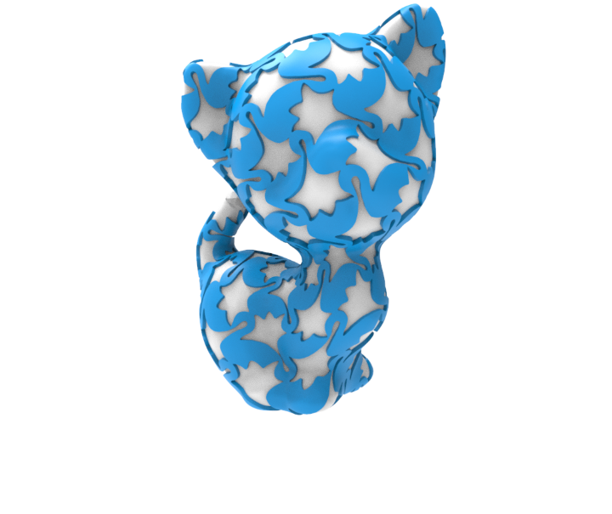
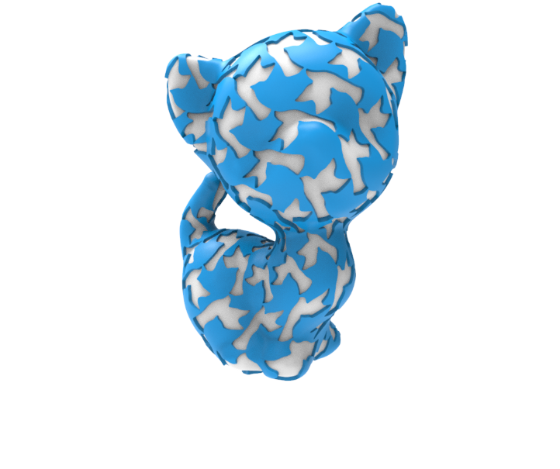
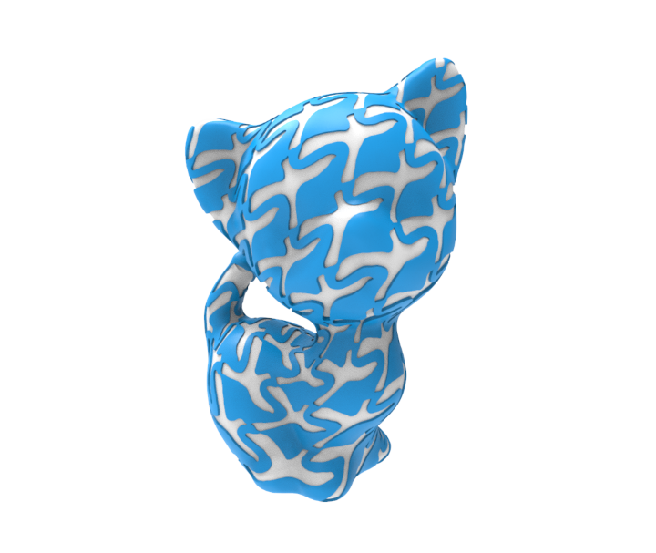
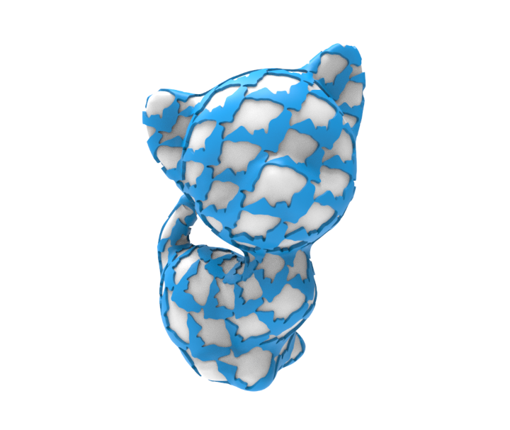
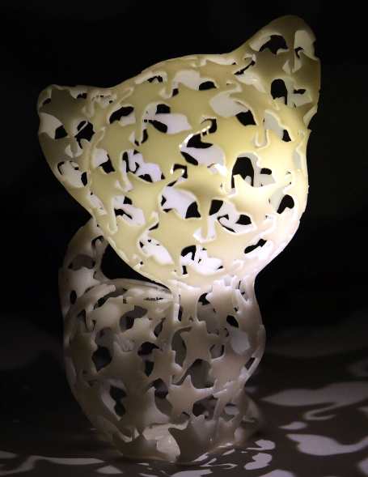
Fabricable Dihedral Escher Tessellations
Xiaokang Liu¹ Lin Lu^{1*} Andrei Sharf² Xin Yan¹
Dani Lischinski³ Changhe Tu¹
Shandong University
Ben-Gurion University of the Negev
Hebrew University of Jerusalem
Notes:
Thank you for the introduction.
My name is Xiaokang Liu from Shandong University.
It’s my pleasure to present our work.

Slide 2
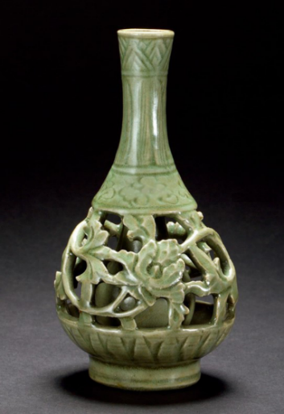
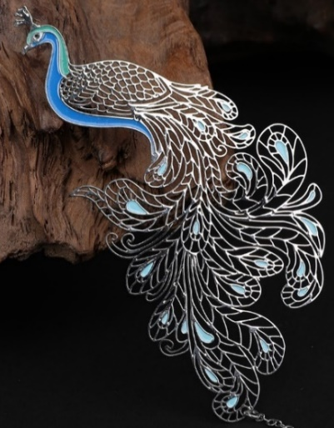
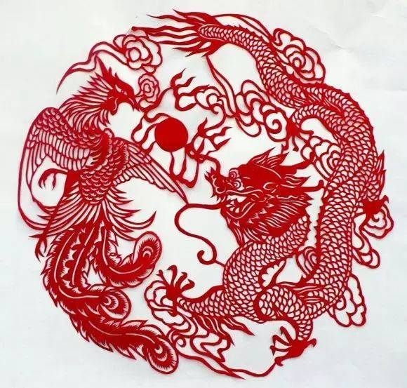

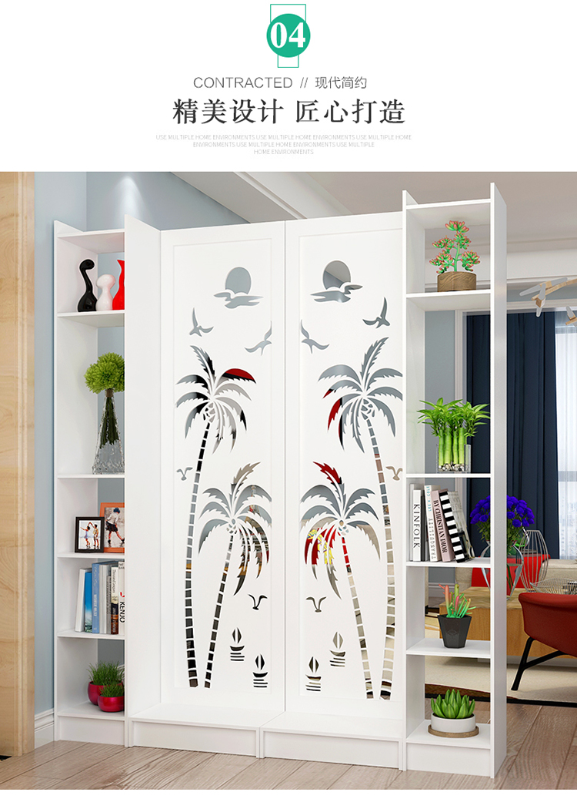
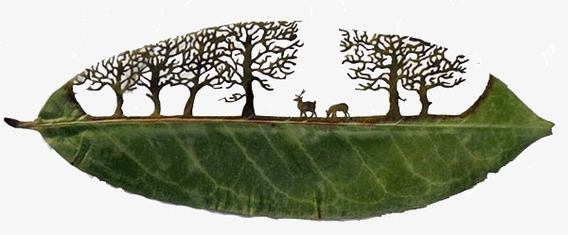
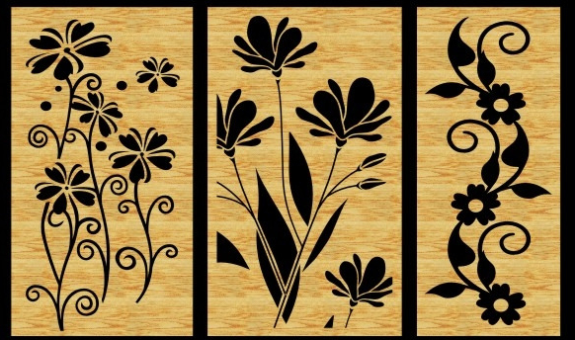
Hollow-out artwork and ornaments
None of them utilizes both solid and hollow spaces simultaneously, though it can bring novel artistic and aesthetic effects.
All images are from internet.
Hollow-out artwork and ornaments expresses contours or an image by the solid or hollow part separately.
Notes:
[click]Hollow-out artwork and ornaments usually [click] have beautiful appearance and a transparent sense of hierarchy
[click] However, most of them express contours or an image by the solid or hollow part separately.
[click] None of them utilizes both solid and hollow spaces simultaneously though it can bring novel artistic and aesthetic effects.

Slide 3
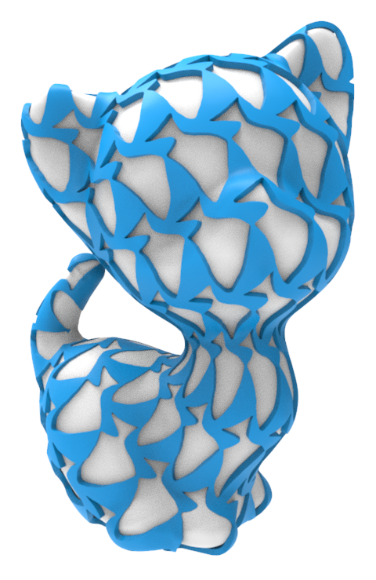
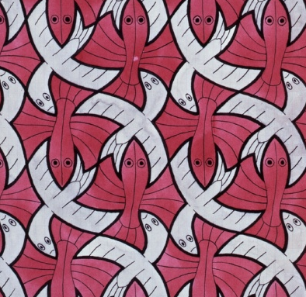
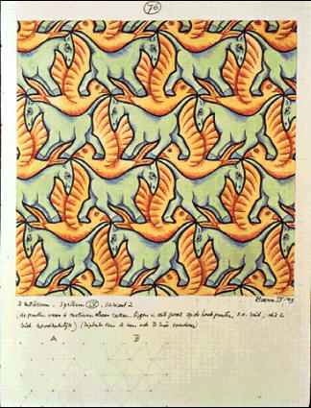
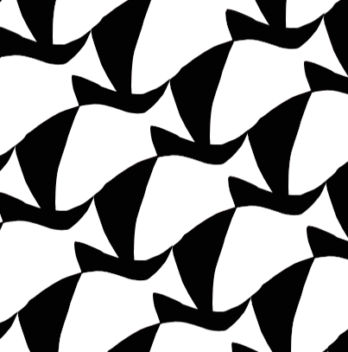
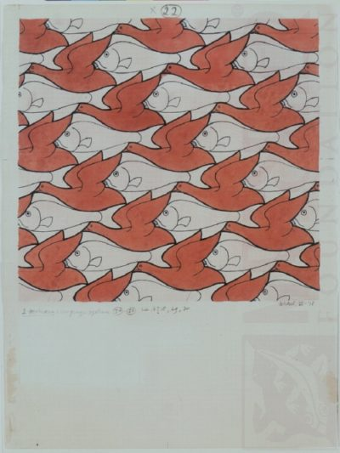
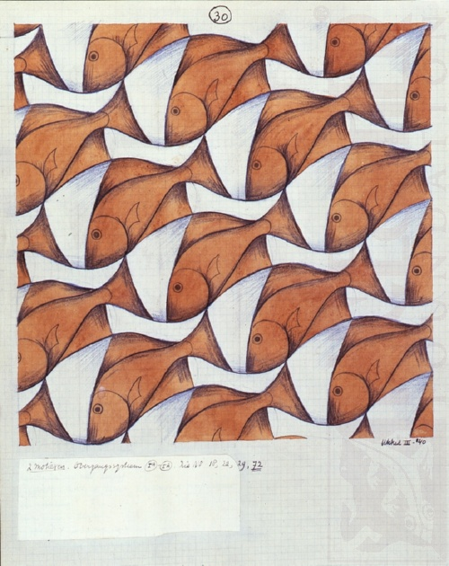
Inspirations — Dual Shape Tessellation
A system to design such a dual tessellation and model fabricable objects.
Artistic work of M.C. Escher
Hollow and solid
A dual Escher model
Mutual surrounding constraint: patterns of the same class always only intersect at points and become the complementary background of other type.
Notes:
[click] Dual shape tilings is a form of graphical art utilizing dual space well. And Escher’s work is one the most well-known, showing how two different types of patterns fit together in a plane.
[click] The two types of figures satisfy the mutual surrounding constraint, so the dual space of those tessellation can be seen as hollow and solid parts naturally.
[click]We observe that such fabrication problem can be reduced to a dihedral tessellation problem in the plane under the constraint.
In order to conveniently and effectively generate more interesting tessellation results,
[click] we aim to offer a system to design such a dual tessellation and model fabricable objects.

Slide 4

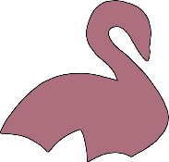
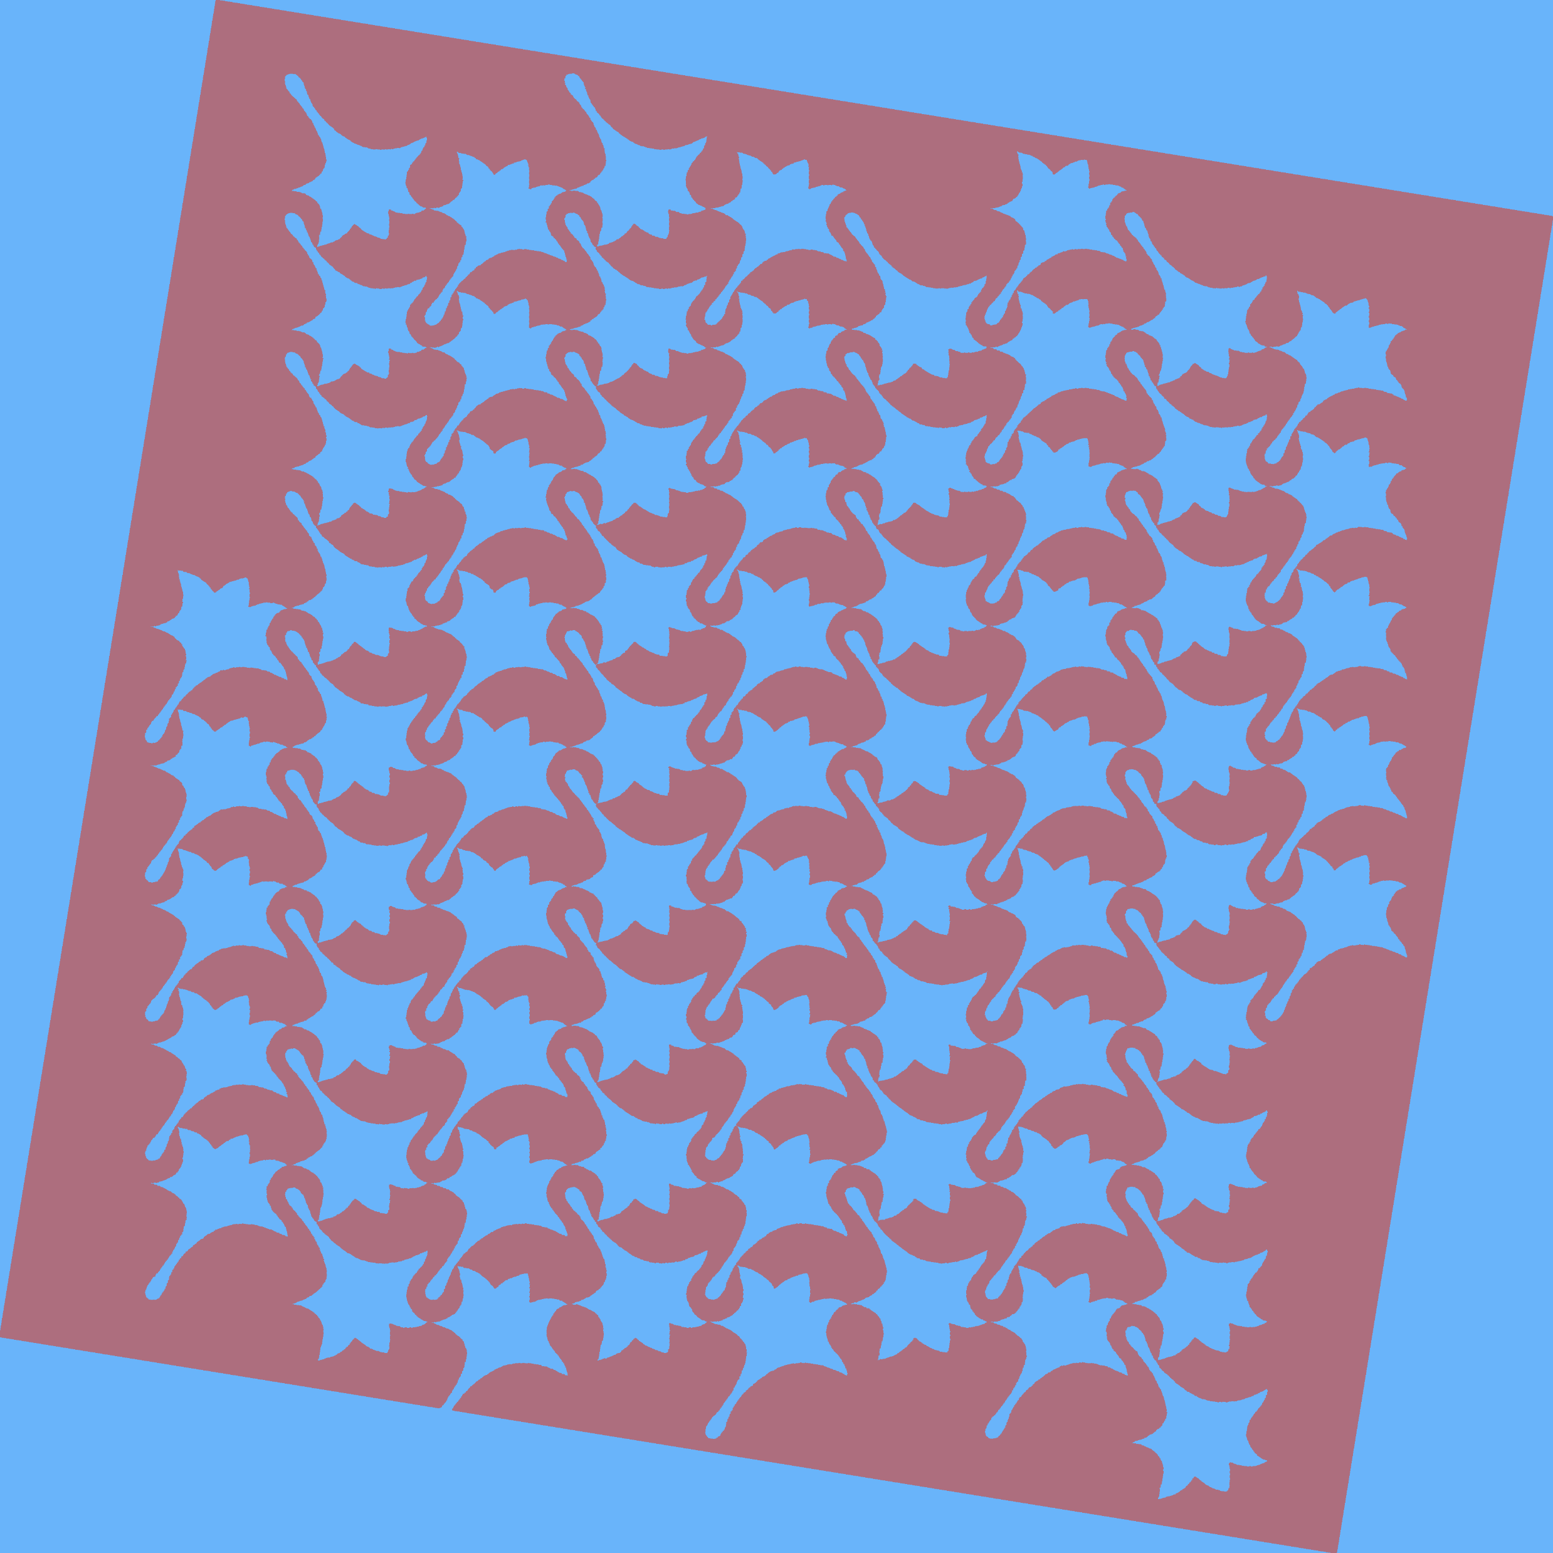
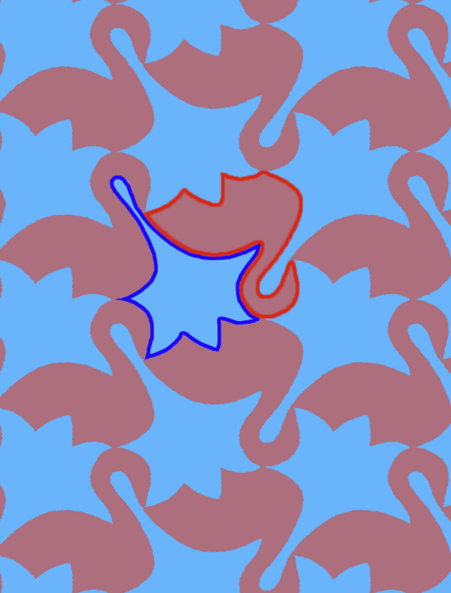
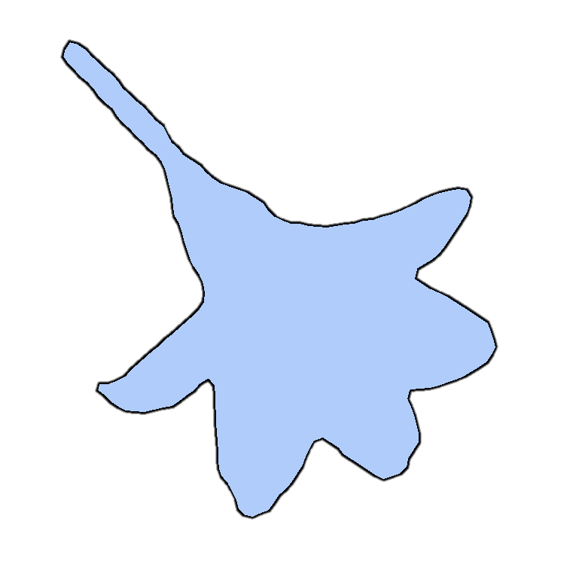
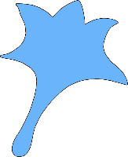
Our goal
Given $S1$, $S2$, compute two target closed patterns $T1$, $T2$, the corresponding tessellation and fabricable model.
Input：
Output patterns：
Fabricable Model：
S1
T1
As similar as possible
S2
T2
Let the system suggest S2 from our database
Notes:
[click] Our goal is that given [click] closed patterns $S1$,$S2$, $\text{[}\text{click}\text{]}$compute two target closed patterns $T1$, $T2\text{,}$the corresponding tessellation and [click] fabricable model. We require that
[click] first. $T1$ and $T2$ are as similar as possible to $S1$and $S2$;
Second $T1$ and $T2$ form a dihedral tessellation under [click] the mutual surrounding constraint;
In fact, we recommend non-professional users to specify S1 and [click] let the system suggest S2 from our database. Since the compatibility between S1 and S2 has a significant impact on the quality of the result.

Slide 5
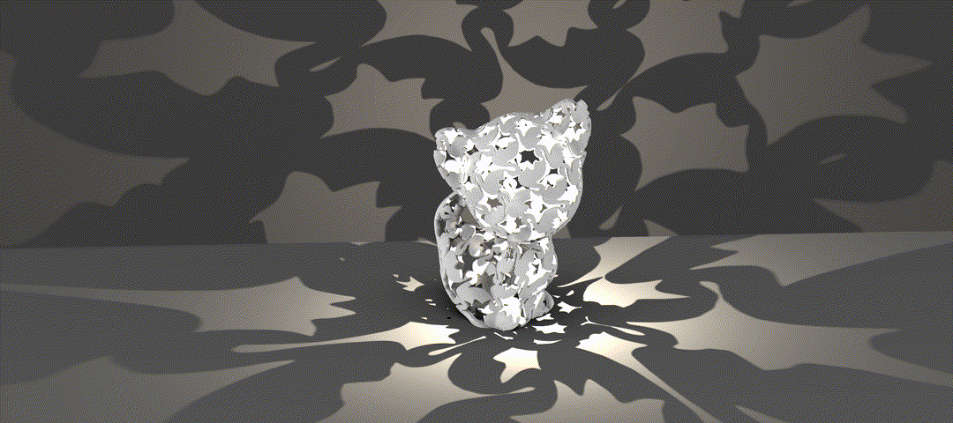

Slide 6
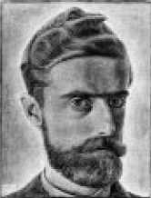
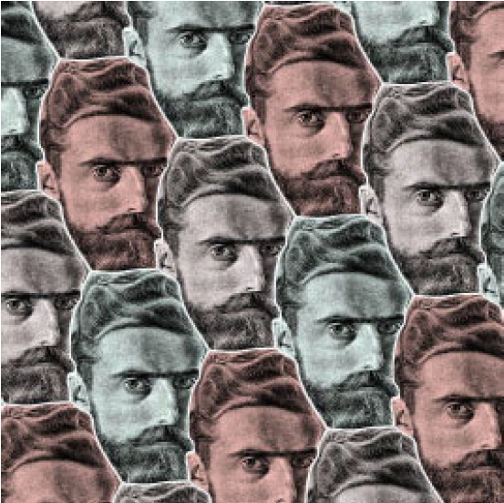
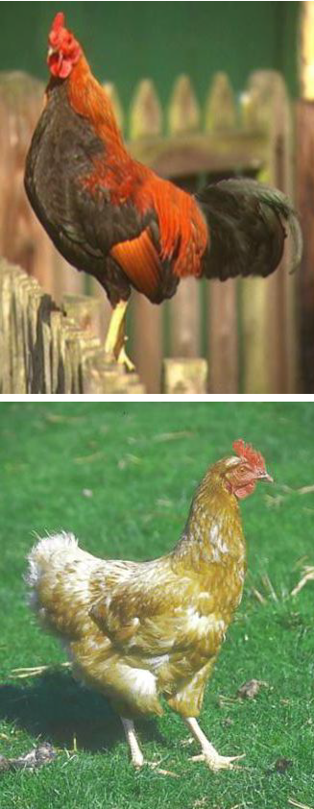
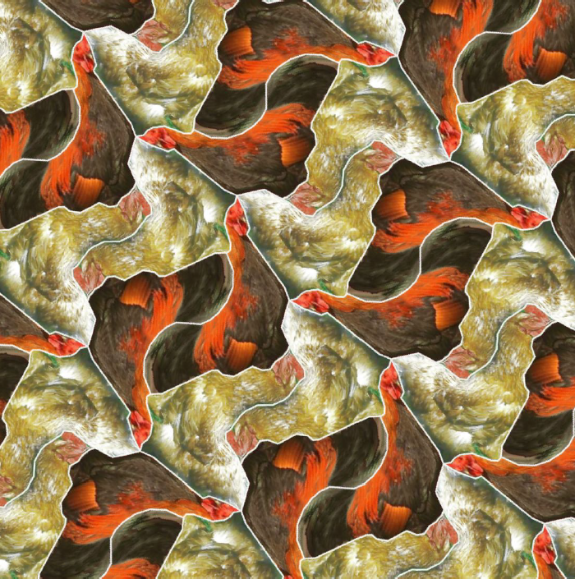
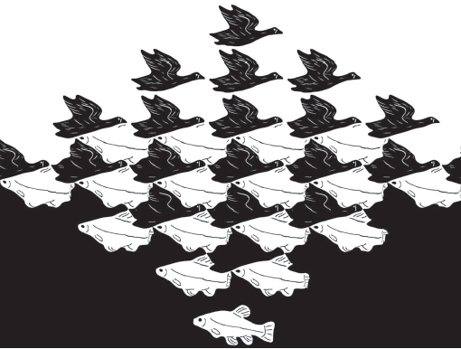

Related Work — Escher tilings
Too much loss of the shape meaning, especially without the assistance of texture.
[Kaplan et al. SIGGRAPH’00]
[Kaplan et al. GI’04]
Similar components addressing the dual shape tiling;
However, ours work is 3D fabrication oriented.
[Koizumi et al. NICOGRAPH’09]
[Lin et al. TVCG’18]
Notes:
[click] Many researchers have conducted a number of related studies.
“Escherization” was initially termed by Kaplan as a problem in computer graphics of tiling a plane with a given closed figure.
[click] In a follow-up, they extend their method to admit two shapes tilings using dihedral tiling patterns.
[click]Their method has Too much loss of the shape meaning, especially without the assistance of texture.
[click] Koizumi et al. formulate Escherization tiling as a maximum eigenvalue problem to allow more complex tile shapes.
[click] And recently Lin et al. proposed a framework integrating matching and warping to generate Escher-like tiles transformations for dual shape perception.
[click] Our work has similar components addressing the dual shape tiling; however, ours is 3D fabrication oriented accounting for specific printability and application requirements

Slide 7
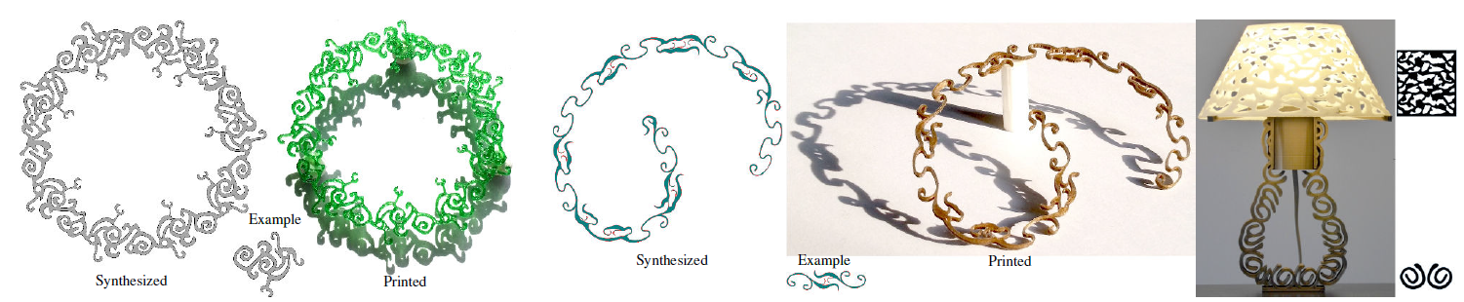
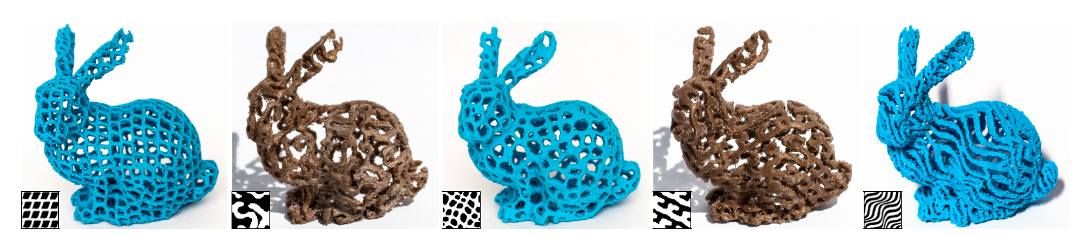
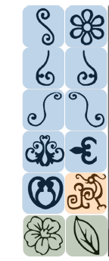
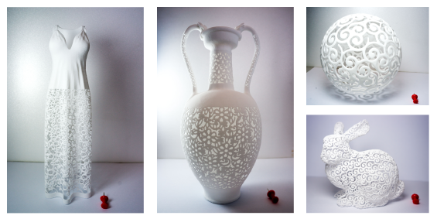
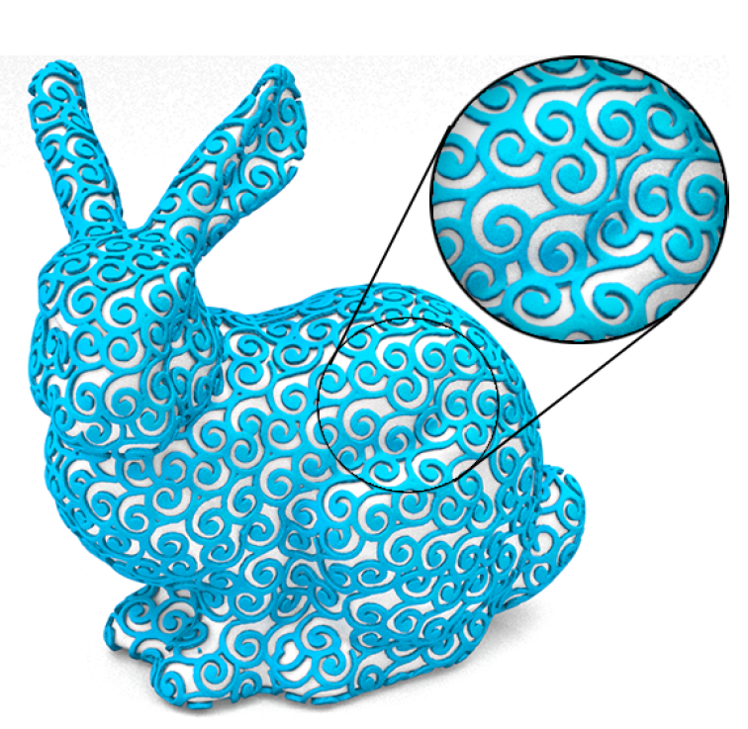
Related Work — Fabricable tilings
[Zhou et al. TOG’14]
[Dumas et al. TOG’15]
Their approach synthesize a set of base elements allowing overlaps.
[Chen et al. TOG’16]
Notes:
[click] Zhou et al. apply Ornaments to fabricated 3D objects by synthesizing 1D patterns along curves with restricted topology
[click]. Dumas et al. synthesized printable 3D patterns demonstrated by modifying texture synthesis to conform with a base surface
[click] Chen et al. synthesized filigree-like structures along surfaces.
[click] However, Their approach synthesize a set of base elements allowing overlaps.
The previous work helped us a lot, but it was far from enough to solve our problems.

Slide 8
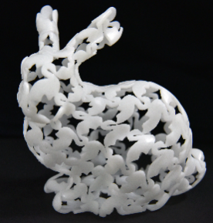
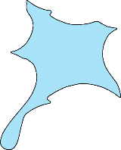
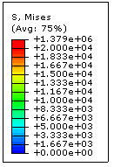



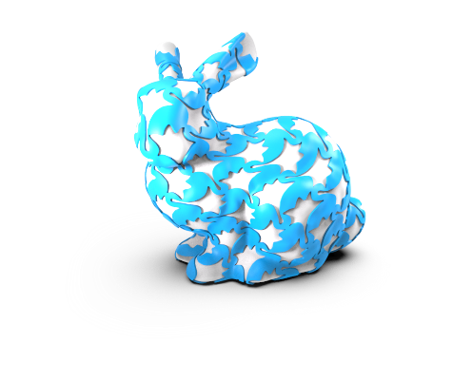
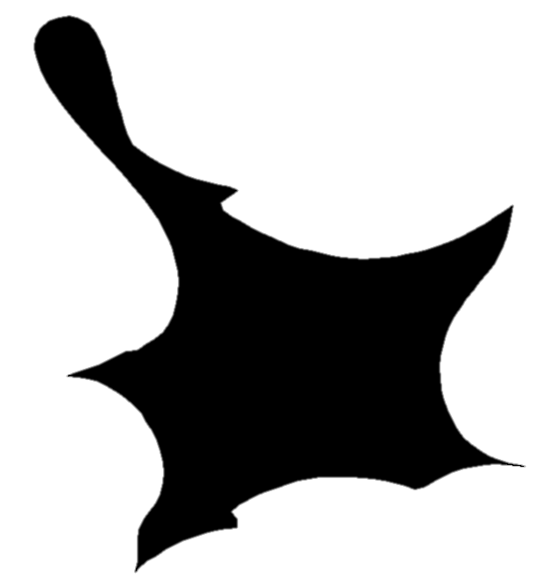
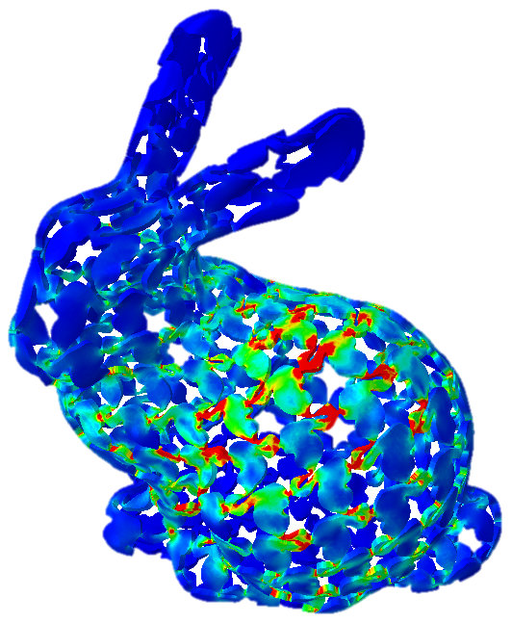



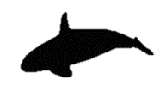
Pipeline
Target shape
Shape morphing
Fabrication
0.959
0.961
0.957
0.975
0.952
0.946
0.948
3D Modeling and Structural Optimization
Tiling and Shape matching
Notes:
So we designed the following pipeline：[click]
Given a target shape and its quadrilateral polygon, [click] we compute a rule-based four tiles pattern and find the best matching shape to the enclosed tile from a database by our system.
[click] We simultaneously morph the two shapes such that they couple together while preserving their visual appearance, resulting in a dual Escher tessellation.
[click] The result can be mapped on a 3D object. After modeling and structure optimization, [click] a fabricable model is generated and efficiently manufactured.

Slide 9
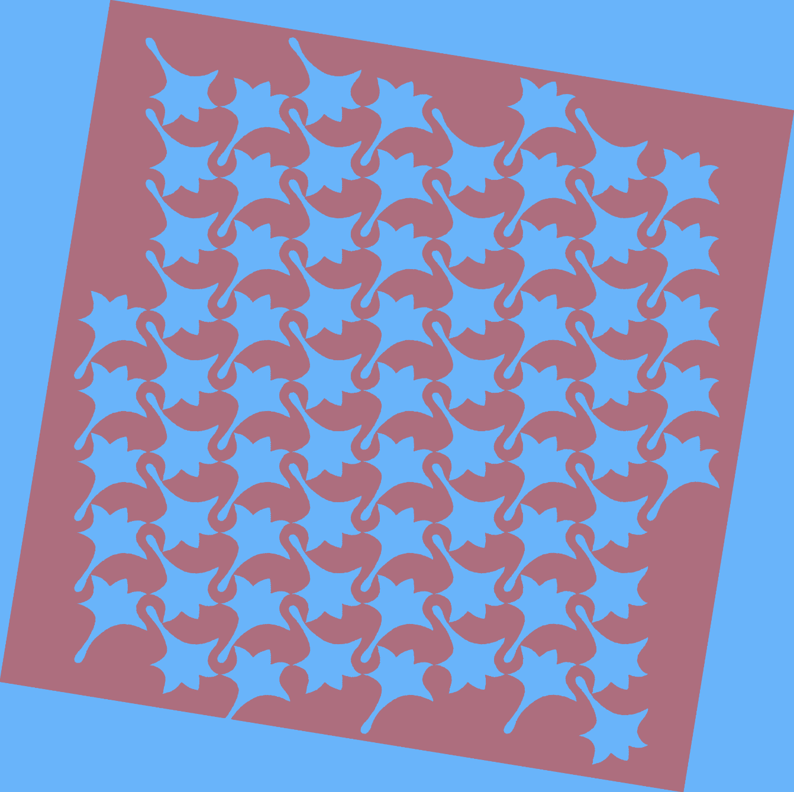

Pipeline
Target shape
Shape morphing
Fabrication
0.959
0.961
0.957
0.975
0.952
3D Modeling and Structural Optimization
0.946
0.948
Tiling and Shape matching
Notes:
First I will explain Tiling and Shape matching

Slide 10
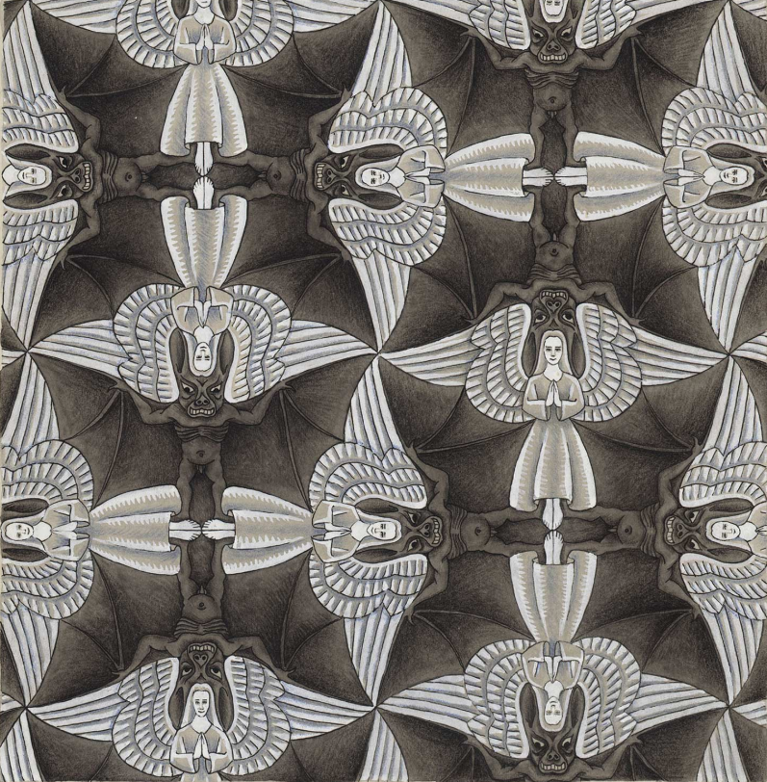
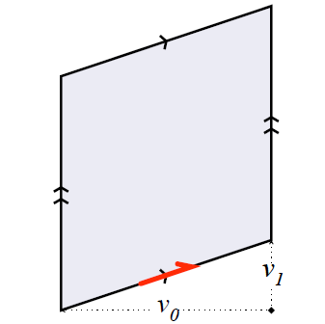
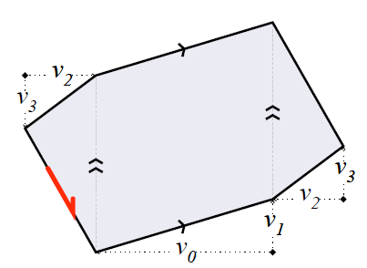
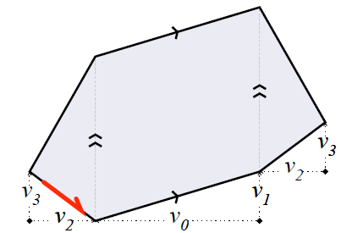
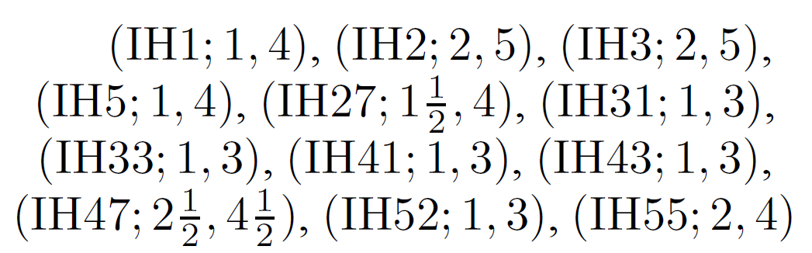
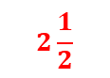
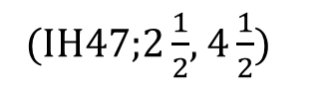
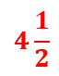
Tiling rules
We adapt three rules from the twelve “heaven and hell” tiling rules in Kaplan’s work^{[1]} to generate our tiling rules.
Our motivation behind this selection is that they generate quad tiles.
5
4
Heaven and Hell by Escher
$$2\frac{1}{2}$$
1
4
$$4\frac{1}{2}$$
2
2
(IH1;1,4)
(IH3;2,5)
(IH47;$2\frac{1}{2}$, $4\frac{1}{2}$)
Twelve “heaven and hell” tiling rules
[1] Dihedral Escherization[C]. Kaplan et al. Graphics Interface, 2004
Notes:
Here we adapt three rules from the twelve “heaven and hell” tiling rules in Kaplan’s work to generate our tiling rules.
[click]Our motivation behind this selection is that they generate quad tiles.
And we adapted these rules to make it more intuitive for placing the initial quadrilateral tiling polygon.

Slide 11




Tiling rules
Translation rule (IH1;1,4):
$$P_{4}$$
$$P_{3}$$
4
4
4
4
3
$$P_{2}$$
3
1
3
3
$$P_{1}$$
1
2
1
1
2
2
2
Notes:
The first is translation rule:
[click]we translate the P1 along the diagonal vector $\vec{13}$ to obtain P2. Then translate P1 and P2 along the diagonal vector $\vec{24}$ to obtain P3 and P4 respectively.

Slide 12
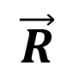





Tiling rules
2
Reflection rule I (IH3;2,5):
1
d
$$P_{3}$$
$$\vec{R}$$
$$P_{4}$$
d
3
4
4
4
2
1
3
3
d
$$P_{1}$$
$$\vec{R}$$
$$P_{2}$$
d
1
1
3
2
2
4
Notes:
The second is reflection rule I:
[click] Translate P1 along the diagonal vector $\vec{24}$ to obtain P3, Flip P1 and P3 around a vector R, then translate them along the vector to obtain P2 and P4 respectively.

Slide 13






Tiling rules
$$P_{4}$$
Reflection rule II (IH3;2,5):
$$P_{2}$$
d
4
d
4
1
4
4
$$\vec{R}$$
3
$$P_{3}$$
$$\vec{R}$$
1
3
3
3
$$P_{1}$$
2
1
1
2
d
2
2
d
Notes:
[click]The third is Reflection rule II, which is similar to Reflection rule I.
Flip and translate.

Slide 14








Tiling rules
1
Rotation rule (IH47;$2\frac{1}{2}$, $4\frac{1}{2}$):
1
4
4
$$180°$$
$$P_{3}$$
3
3
4
2
2
2
2
1
3
$$P_{2}$$
3
3
$$180°$$
2
1
4
4
3
2
1
4
1
$$180°$$
$$P_{4}$$
1
1
4
4
4
$$P_{1}$$
1
2
2
3
3
Notes:
The last is rotation rule:
[click] Rotate P1 around its tiling vertex #1 to obtain P2. Rotate P2 around vertex #2 to obtain P3 and so on.

Slide 15











Tiling rules
4
4
4
4
1
4
2
$$P_{4}$$
3
$$P_{3}$$
4
$$P_{4}$$
3
$$P_{3}$$
3
1
$$P_{4}$$
3
1
3
3
1
1
1
$$P_{2}$$
2
2
2
$$P_{3}$$
2
2
3
$$P_{2}$$
3
1
2
4
3
2
4
4
4
4
2
2
4
1
$$P_{4}$$
4
3
3
$$P_{3}$$
3
1
$$P_{2}$$
$$P_{1}$$
1
$$P_{2}$$
3
1
4
4
$$P_{1}$$
3
1
1
3
$$P_{1}$$
2
$$P_{1}$$
1
1
2
2
1
4
2
2
2
3
Translation rule
Reflection rule I
Reflection rule II
Rotation rule
The rules guarantee that the four tiles are touching each other, enclosing an isolated area in their interior.
The rotation rule requires the tiling polygon to be a parallelogram.
Notes:
[click] These rules guarantee that the four tiles are touching each other, enclosing an isolated area in their interior.
[click] And the rotation rule requires the tiling polygon to be a parallelogram.

Slide 16



Rule-based tiling
Determine quadrilateral tiling polygon;
Extend tiling pattern to the whole plane.
Input
Candidate points
Quadrilateral tiling polygon
4
4
4
4
3
1
4
4
3
3
2
$$P_{4}$$
$$P_{3}$$
$$P_{4}$$
$$P_{3}$$
1
$$P_{4}$$
$$P_{2}$$
3
1
3
$$P_{3}$$
3
1
1
3
1
2
2
2
3
1
2
2
2
$$P_{2}$$
2
4
4
4
4
4
3
2
4
2
4
3
1
$$P_{4}$$
$$P_{2}$$
3
$$P_{1}$$
3
1
$$P_{2}$$
3
1
$$P_{3}$$
1
4
4
$$P_{1}$$
3
1
1
3
1
$$P_{1}$$
2
$$P_{1}$$
1
1
2
2
2
2
4
2
3
Translation rule
Reflection rule I
Reflection rule II
Rotation rule
Notes:
[click] Then starting with one shape, we compute its candidate points，and determine a quadrilateral tiling polygon by randomly selecting four points from them.
[click] Following these rules, the tiling pattern can be
[click]extended to the whole plane through repeated replications of the initial tile.

Slide 17

Shape Matching
Enclosed space M, compute a best matching pattern $S2$.
Triangle-area representation (TAR) ^{[2]}
0.959
0.961
0.957
M
S2
0.975
0.952
0.946
0.948
Enclosed space
Matching in database
Best matching
[2] Geometry-based image retrieval in binary image databases, Alajlan et al. IEEE Transactions on Pattern Analysis & Machine Intelligence, 2008.
Notes:
[click] We denote the enclosed space between the four tiled shapes by M.
[click] Then we use the triangle-area representation (TAR) to compute
[click] a best matching of S2 to M from our database.

Slide 18



Pipeline
Shape morphing
Target shape
Fabrication
0.959
0.961
0.957
0.975
0.952
0.946
0.948
3D Modeling and Structural Optimization
Tiling and Shape matching
Notes:
Then we compute the final pattern by shape morphing.

Slide 19





Shape Morphing
Objective function:
S1
T1
$E_{sim}\left(T_{1},T_{2}\right)=λF\left(T_{1},S_{1}\right)+\left(1−λ\right)F\left(T_{2},S_{2}\right)$ (1)
deformation weight
$λ=0.5$ in experiments
M
T2
$F\left(T,S\right)=φ\left(T,S\right)+Insec\left(T,S\right)−ω\left(T,S\right)$ (2)
shape similarity based on TAR descriptors
penalizes self-intersections in T or S with a high score in the range $[1−2]$.
S2
$φ\left(T,S\right)=(Area\left(T∪S\right)−Area\left(T∩S\right)/Area\left(T∪S\right)$ (3)
Notes:
In this step,
[click] our aim is to find an optimal transformation of S1 and M into T1 and T2.
[click] The objective function is:
[click] $λ$ is a deformation weight
[click] and F measures the degree of deformation from S to T :
[click] $ω\left(T,S\right)$ is shape similarity based on TAR descriptors,
[click] Insec is a punitive score penalizing self-intersections in T or S.
[click] and $φ\left(T,S\right)$ is the area function defined as follow:
To minimize Esim( T1; T2) and maintain the coupling of T1 and T2, we perform shape morphing
[click] between M and S2. and the shape T1 is defined from the distortion of T2.

Slide 20





Shape Morphing
Two-level hierarchical interpolation:
Align M and $S2$ and compute their corresponding frame polygons;
Morph each interval of contour into intermediate shapes.
T1
M
S2
T2
T2
Note that the four tiling vertices stay fixed through to ensure the connectivity of tiles in the final tiling.
Corresponding frame polygons
Intermediate shapes
Notes:
In the process of morphing,
[click] We employ a two-level hierarchical interpolation algorithm.:
First align M and S2 and compute their corresponding frame polygons according to the tiling vertices and feature points.
[click] Then, we morph each interval of contour into intermediate shapes
[click] to obtain the optimized result of T1 and T2.
[click] The four tiling vertices stay fixed through the morphing process thus ensuring the connectivity of tiles in the final tiling.

Slide 21













Tessellation Result
Tessellation
results
Different
S2
The top five dihedral tiling results for a given dove shape (left).
The rightmost dog is a failure example though it minimizes $E_{sim}$. Cause the results are less meaningful due to large deformations in the simultaneous optimizations.
Notes:
Given a dove shape as input,
[click] our system generates the top five dihedral tiling results.
[click] The rightmost dog is a failure example though it minimizes $E_{sim}$. Cause the results are less meaningful due to large deformations in the simultaneous optimizations.

Slide 22










Tessellation Result
Various dual-shape tiling patterns generated by our system:
Notes:
Here are Various dual-shape tiling patterns generated by our system.

Slide 23




Comparison
[Lin et al. TVCG’18]
[Our method]
Our method better preserves the contour geometry and thus the shape visual appearance and quality, especially in the black frame where the two shapes are coexist in the middle.
Notes:
We show a gradual deformation to achieve the sky-and-water pattern of Lin’s work. [click] The comparison shows that our method better preserves the contour geometry and thus the shape visual appearance and quality, especially in the black frame where the two shapes are coexist.

Slide 24
Pipeline
Target shape
Fabrication
Shape morphing
0.959
0.961
0.957
0.975
0.952
0.946
0.948
Tiling and Shape matching
3D Modeling and Structural Optimization
Notes:
After obtaining the dual tessellation, we will generate the fabricable model by 3D modeling and Structure Optimization.

Slide 25




3D Modeling & Structural Optimization
Map 3D to 2D by an As-rigid-as-possible parameterization method^{[3]};
Compute the boolean difference between 2D tiling pattern and parameterized mesh;
Map back to 3D and extrude each vertex to obtain a dual-tile shell model $ℳ$.
Parameterization
Boolean difference
A shell model
[3] A local/global approach to mesh parameterization, Liu L et al. Computer Graphics Forum, 2008
Notes:
[click] First map the input 3D mesh model onto 2D parameter domain;
[click] second, Overlay the 2D tiling pattern onto the parameterized mesh and compute the boolean difference between them;
[click] Then we Map back the planar triangular mesh to three-dimensional space and extrude each vertex to obtain a dual-tile shell model.

Slide 26



3D Modeling & Structural Optimization
Two-step optimization scheme:
Increase the area of connectors to enforce connectivity between the weak part and its solid neighborhood by locally dilating the contour of the solid shapes.
The initial result
After dilating the contour
Upper bound: 1% of the 3D shape’s diagonal length.
Notes:
[click] To increase strength, we perform a two-step optimization scheme.
[click] First, Increase the area of connectors to enforce connectivity between the weak part and its solid neighborhood,
[click] we do this by locally dilating the contour of the solid shapes by a step size until reaching the upper bound.

Slide 27





3D Modeling & Structural Optimization
Two-step optimization scheme:
Increase the area of connectors to enforce connectivity between the weak part and its solid neighborhood.
Increase the thickness of the model for each weak surface vertex.
structural analysis to detect the weak part
Notes:
[click] Next, we increase the thickness of the model for each weak surface vertex.

Slide 28
Pipeline
Fabrication
Target shape
Shape morphing
0.959
0.961
0.957
0.975
0.952
0.946
0.948
3D Modeling and Structural Optimization
Tiling and Shape matching
Notes:
The last stage is fabrication.

Slide 29














Fabrication
Swan and lily
Swan and bird
Two birds
Bat and fish
Notes:
Here are several fabricated 3D models with our dual shape textures

Slide 30

Fabrication & Applications
A light source emanates through the hollow tiles, producing interesting light and shadow effects.
Some fabricated models with inner light source
Notes:
A potential application is customized lampshade with a light source in the model. The light emanates through the hollow tiles in the pattern, producing interesting light and shadow effects.

Slide 31

Fabrication & Applications
Relax the mutual surrounding constraints, such that each element has connections with two neighbors. Thus, both patterns can be fabricated in one connected piece.
Top row: Two respectively printed pieces are assembled together.
Bottom row: A paper is cut into two connected pieces.
Notes:
We can also relax the mutual surrounding constraints for each tile, such that each element has connections with two neighbors that belong to the same shape type. Thus, both patterns can be fabricated in one connected piece.

Slide 32
Fabrication & Applications
Our 3D manufactured custom Escher blinds with one rotation hinge on horizontal lily tiles, which allows the lily pattern to rotate with one degree of freedom simulating the behavior of window blinds.
Rotation hinge
Swan-and-lily blinds with rotation hinge
Notes:
Our 3D manufactured custom Escher blinds with one rotation hinge on horizontal lily tiles.
The lily pattern can rotate with one degree of freedom simulating the behavior of window blinds.

Slide 33
Tessellation Applications
Halftoning: We control the halftoning amount by the tile scale parameter.
Lena and corresponding halftoning
Notes:
We also adapt the tessellation result into a halftoning application, due to their controllability and continuous tessellation of the plane.
We control the halftoning amount by the tile scale parameter, since the tessellation structure is fixed.
This is lena and corresponding halftoning by our swan and lily tessellation.

Slide 34




Conclusion
Model and fabricate Escher dual-shape tilings from user-defined shapes.
Accounts for strength and connectivity to conform with 3D printability requirements.
Notes:
In conclusion, we present a novel approach to model and fabricate Escher dual-shape tilings from user-defined shapes.
To conform with 3D printability requirements, our tiling computation accounts for strength and connectivity.

Slide 35



Limitations & Future work
Seams and distortion
Limited types of tiling rules
Seams
Distortion
Notes:
Of course, Our approach has some limitations.
[click] First, it requires a genus 0 input model, so we need to cut the closed model. It leads seams. Currently we just put them in the hidden places of the model, such as the bottom and back of the bunny.
[click] Similarly, great distortion occurs in some sharp areas of high curvature, cause the tessellation texture were stretched in parameterization.
[click] Second, the above rules are limited cause we just select those that generate good quad tiles. In the future, we will explore more interesting potential rules.

Slide 36

Thank you for your attention!
Models, database online:
http://irc.cs.sdu.edu.cn/Dihedral/index.html
Notes:
All data, results and models are presented on our project page:
Thank you for your attention.

